Slide 1

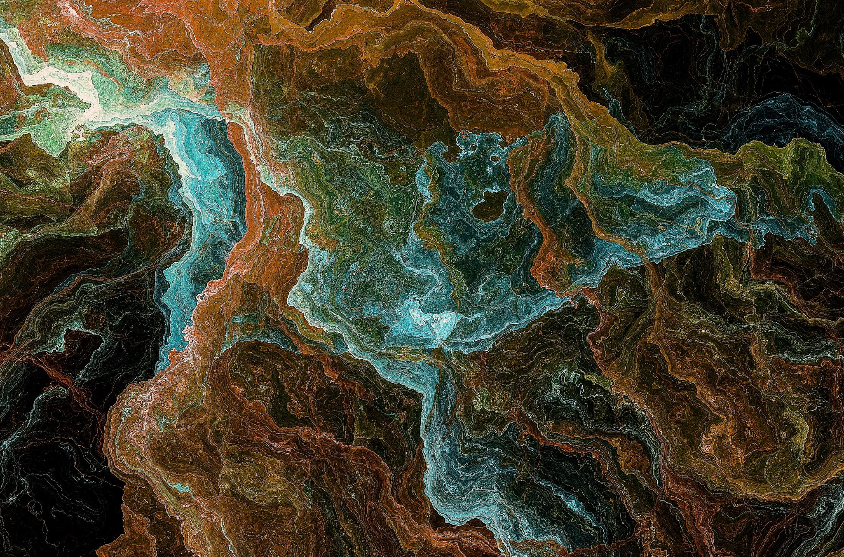
mmFace: 3D Face Recognition using RGB and Millimetre Wave Radar
Stergious Aji

Slide 2
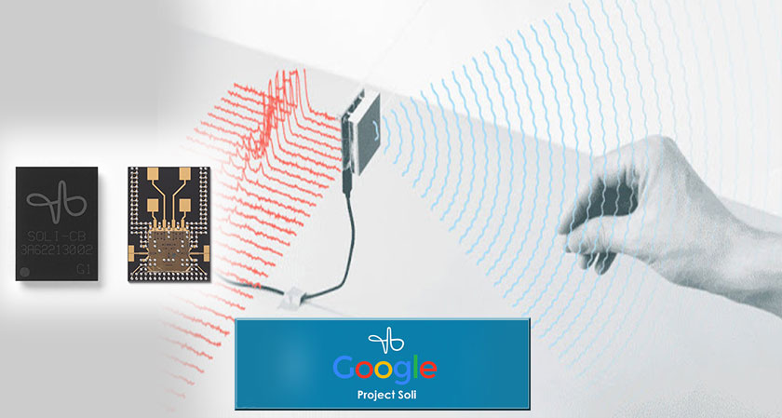
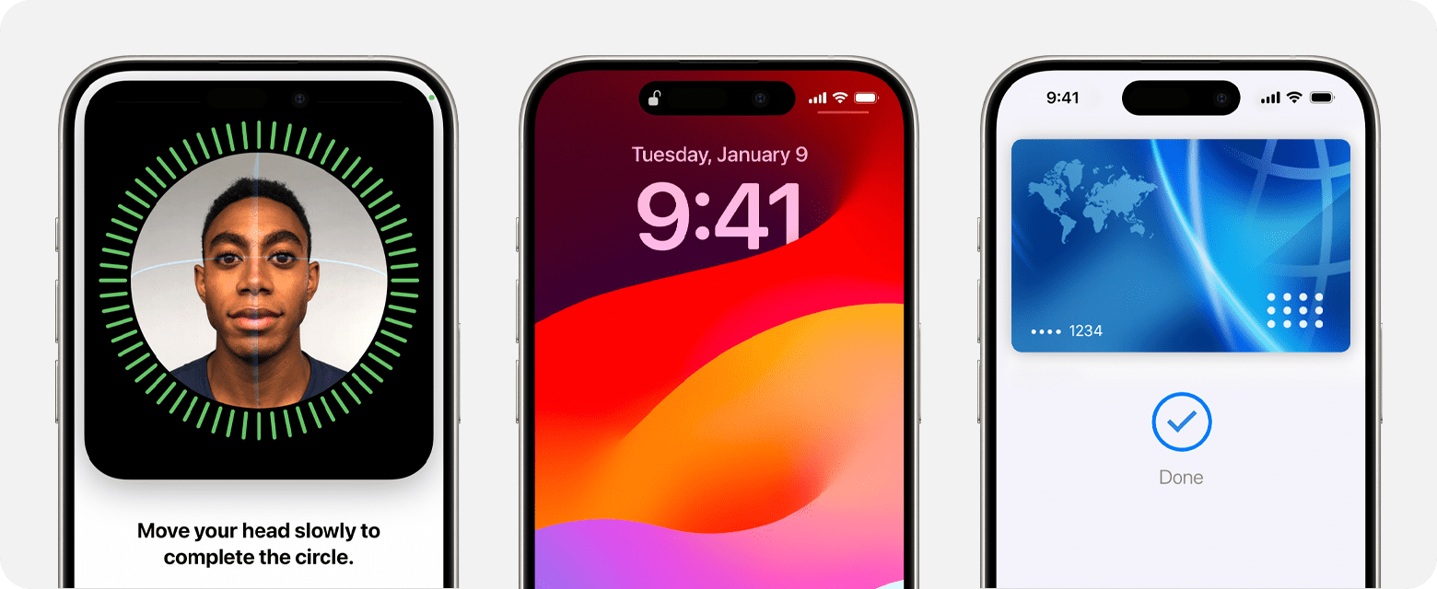
Motivations
Face recognition is a more naturally accessible way of authenticating identity
Current systems employing NIR sensors have limitations
Apple’s Face ID is prominent example
Uses costly proprietary hardware and hidden behind patents
Compact mmWave sensing has excelled in autonomous vehicles
Google’s Soli Project successfully uses it for hand gesture recognition
Notes:
Firstly, let’s cover the Automatic Videography of Audio.
We aimed to make a tool that autonomously generates illustrated videos for any audio source. This is done by sequencing relevant images that correspond to the spoken language found in the audio.
Motivations:
Past decades have witnessed a rise in popularity of video production on platforms such as YouTube, Instagram, and TikTok etc.
It is often the case that many ‘music videos’ on YouTube lack any video content. Merely showcasing the album cover art. This can be detrimental to their prosperity. Number of reasons for this:
Artists/Bands lack funding, resources and capability to make music videos. Or song not popular enough to warrant the effort.
More commonly arises from older tracks digitised from analogue format to be uploaded to platform.
Studies have proven that introducing multimodality to content can increase user retention, not to mention accessibility.
This could be beneficial with educational material since bringing visual, audio and textual elements can cater to diverse learning styles
Finally, our system intends to enhance and generalise the functionality of the previous automated videography system by Andrew Parker.

Slide 3

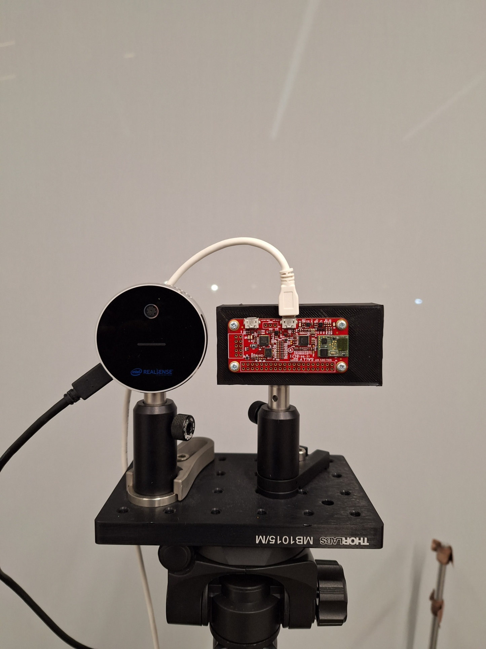
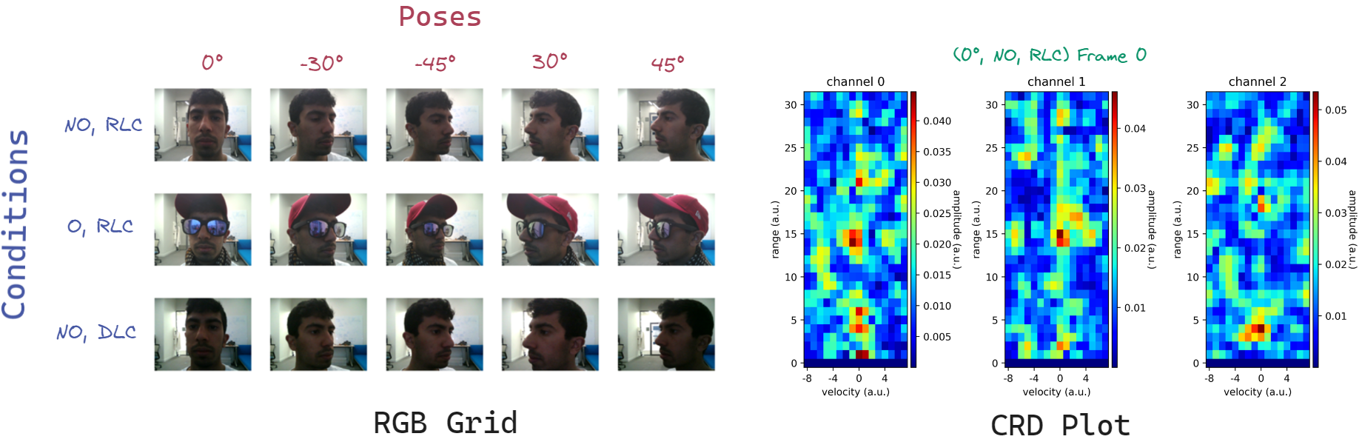
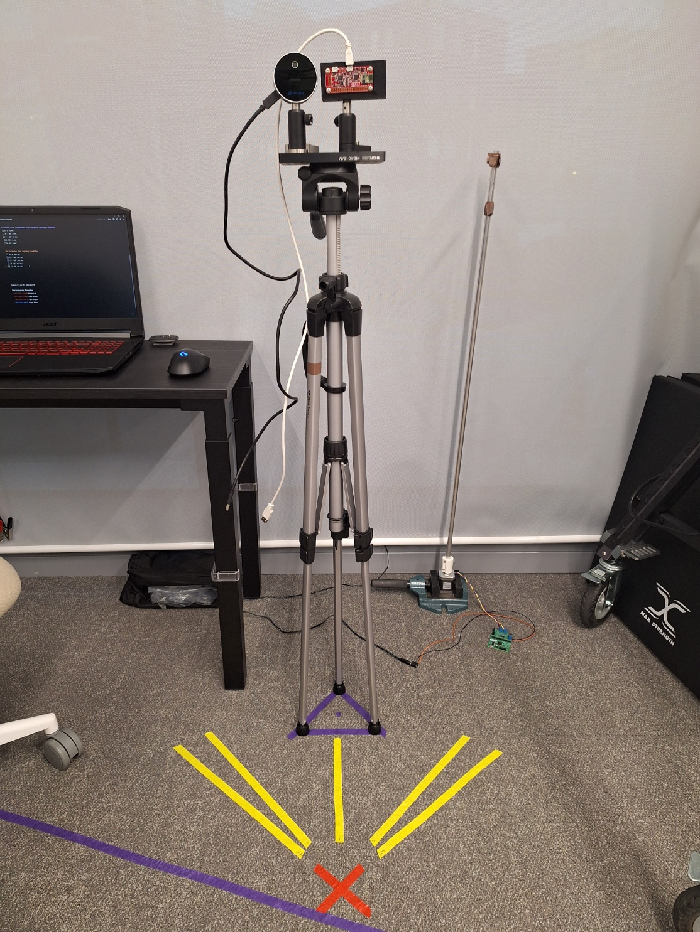
Data Acquisition
Intel Realsense RGB-D camera
Google’s Soli 60 GHz radar sensor
Notes:
Firstly, let’s cover the Automatic Videography of Audio.
We aimed to make a tool that autonomously generates illustrated videos for any audio source. This is done by sequencing relevant images that correspond to the spoken language found in the audio.
Motivations:
Past decades have witnessed a rise in popularity of video production on platforms such as YouTube, Instagram, and TikTok etc.
It is often the case that many ‘music videos’ on YouTube lack any video content. Merely showcasing the album cover art. This can be detrimental to their prosperity. Number of reasons for this:
Artists/Bands lack funding, resources and capability to make music videos. Or song not popular enough to warrant the effort.
More commonly arises from older tracks digitised from analogue format to be uploaded to platform.
Studies have proven that introducing multimodality to content can increase user retention, not to mention accessibility.
This could be beneficial with educational material since bringing visual, audio and textual elements can cater to diverse learning styles
Finally, our system intends to enhance and generalise the functionality of the previous automated videography system by Andrew Parker.

Slide 4
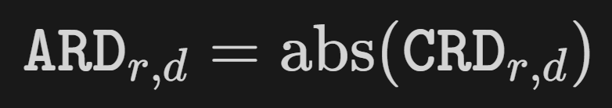
Data Preprocessing
Notes:
Firstly, let’s cover the Automatic Videography of Audio.
We aimed to make a tool that autonomously generates illustrated videos for any audio source. This is done by sequencing relevant images that correspond to the spoken language found in the audio.
Motivations:
Past decades have witnessed a rise in popularity of video production on platforms such as YouTube, Instagram, and TikTok etc.
It is often the case that many ‘music videos’ on YouTube lack any video content. Merely showcasing the album cover art. This can be detrimental to their prosperity. Number of reasons for this:
Artists/Bands lack funding, resources and capability to make music videos. Or song not popular enough to warrant the effort.
More commonly arises from older tracks digitised from analogue format to be uploaded to platform.
Studies have proven that introducing multimodality to content can increase user retention, not to mention accessibility.
This could be beneficial with educational material since bringing visual, audio and textual elements can cater to diverse learning styles
Finally, our system intends to enhance and generalise the functionality of the previous automated videography system by Andrew Parker.

Slide 5
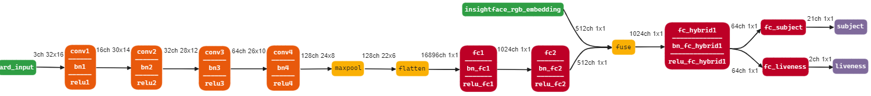



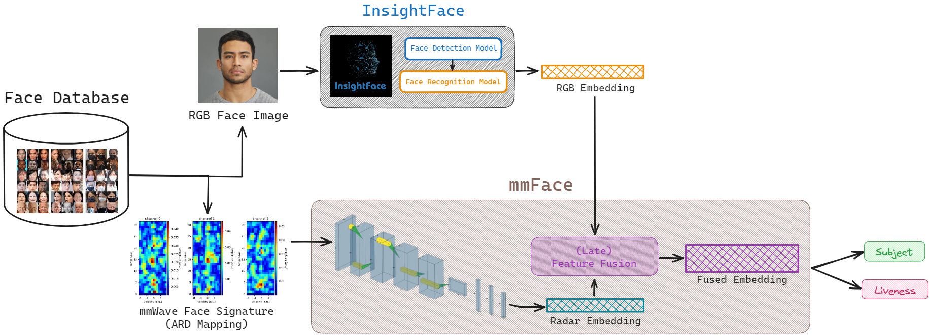
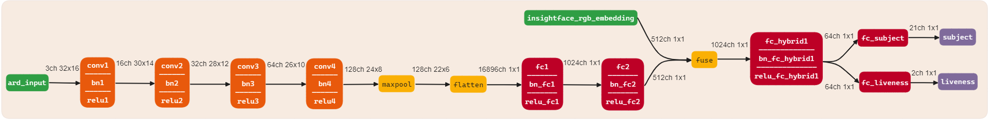
Model Architecture
Notes:
Firstly, let’s cover the Automatic Videography of Audio.
We aimed to make a tool that autonomously generates illustrated videos for any audio source. This is done by sequencing relevant images that correspond to the spoken language found in the audio.
Motivations:
Past decades have witnessed a rise in popularity of video production on platforms such as YouTube, Instagram, and TikTok etc.
It is often the case that many ‘music videos’ on YouTube lack any video content. Merely showcasing the album cover art. This can be detrimental to their prosperity. Number of reasons for this:
Artists/Bands lack funding, resources and capability to make music videos. Or song not popular enough to warrant the effort.
More commonly arises from older tracks digitised from analogue format to be uploaded to platform.
Studies have proven that introducing multimodality to content can increase user retention, not to mention accessibility.
This could be beneficial with educational material since bringing visual, audio and textual elements can cater to diverse learning styles
Finally, our system intends to enhance and generalise the functionality of the previous automated videography system by Andrew Parker.

Slide 6
Feature-level Fusion Strategies
Concatenate
Add
Hadamard Product
Pairwise Dot Mean
Pairwise Dot Max
Pairwise Dot Mean
Multi-Head Attention
Notes:
Firstly, let’s cover the Automatic Videography of Audio.
We aimed to make a tool that autonomously generates illustrated videos for any audio source. This is done by sequencing relevant images that correspond to the spoken language found in the audio.
Motivations:
Past decades have witnessed a rise in popularity of video production on platforms such as YouTube, Instagram, and TikTok etc.
It is often the case that many ‘music videos’ on YouTube lack any video content. Merely showcasing the album cover art. This can be detrimental to their prosperity. Number of reasons for this:
Artists/Bands lack funding, resources and capability to make music videos. Or song not popular enough to warrant the effort.
More commonly arises from older tracks digitised from analogue format to be uploaded to platform.
Studies have proven that introducing multimodality to content can increase user retention, not to mention accessibility.
This could be beneficial with educational material since bringing visual, audio and textual elements can cater to diverse learning styles
Finally, our system intends to enhance and generalise the functionality of the previous automated videography system by Andrew Parker.

Slide 7
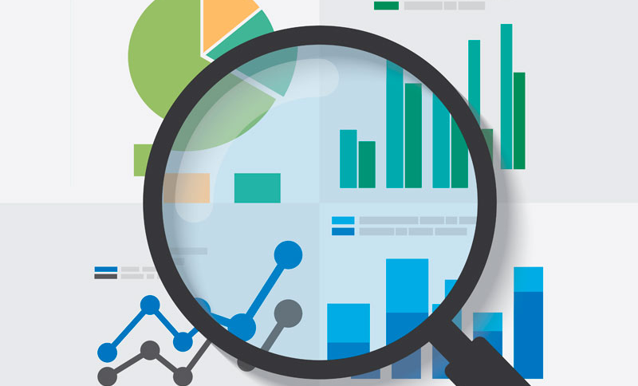
EVALUATION

Slide 8
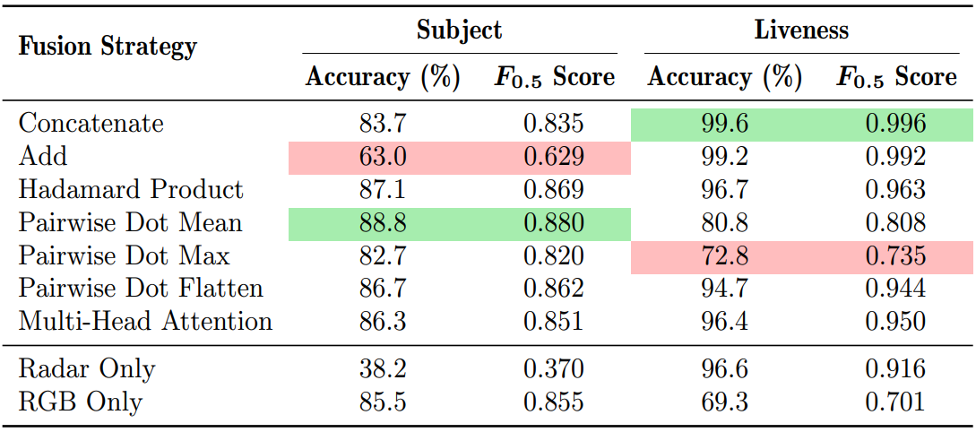
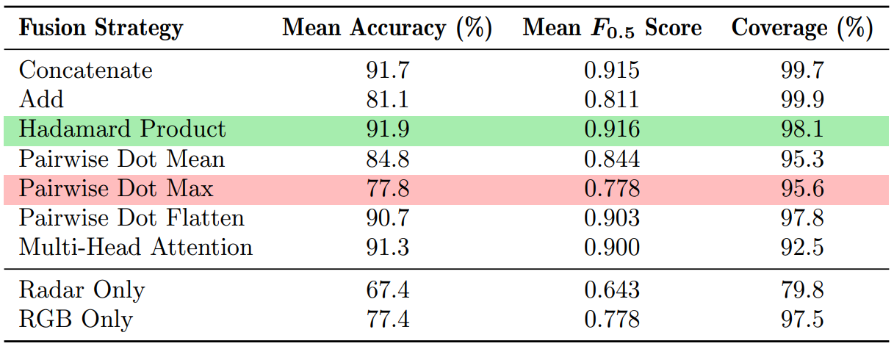
Zero-shot Classification Accuracy
Notes:
Firstly, let’s cover the Automatic Videography of Audio.
We aimed to make a tool that autonomously generates illustrated videos for any audio source. This is done by sequencing relevant images that correspond to the spoken language found in the audio.
Motivations:
Past decades have witnessed a rise in popularity of video production on platforms such as YouTube, Instagram, and TikTok etc.
It is often the case that many ‘music videos’ on YouTube lack any video content. Merely showcasing the album cover art. This can be detrimental to their prosperity. Number of reasons for this:
Artists/Bands lack funding, resources and capability to make music videos. Or song not popular enough to warrant the effort.
More commonly arises from older tracks digitised from analogue format to be uploaded to platform.
Studies have proven that introducing multimodality to content can increase user retention, not to mention accessibility.
This could be beneficial with educational material since bringing visual, audio and textual elements can cater to diverse learning styles
Finally, our system intends to enhance and generalise the functionality of the previous automated videography system by Andrew Parker.

Slide 9
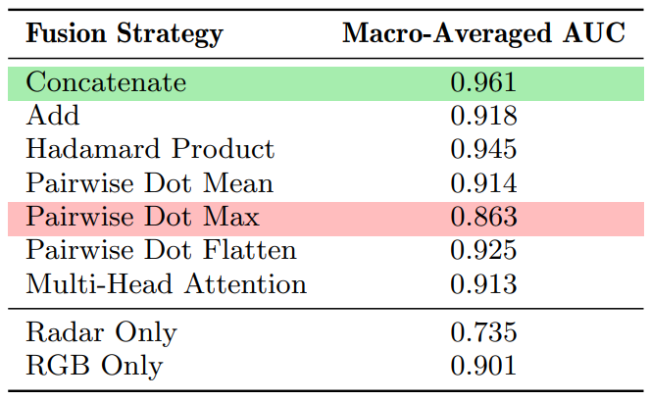
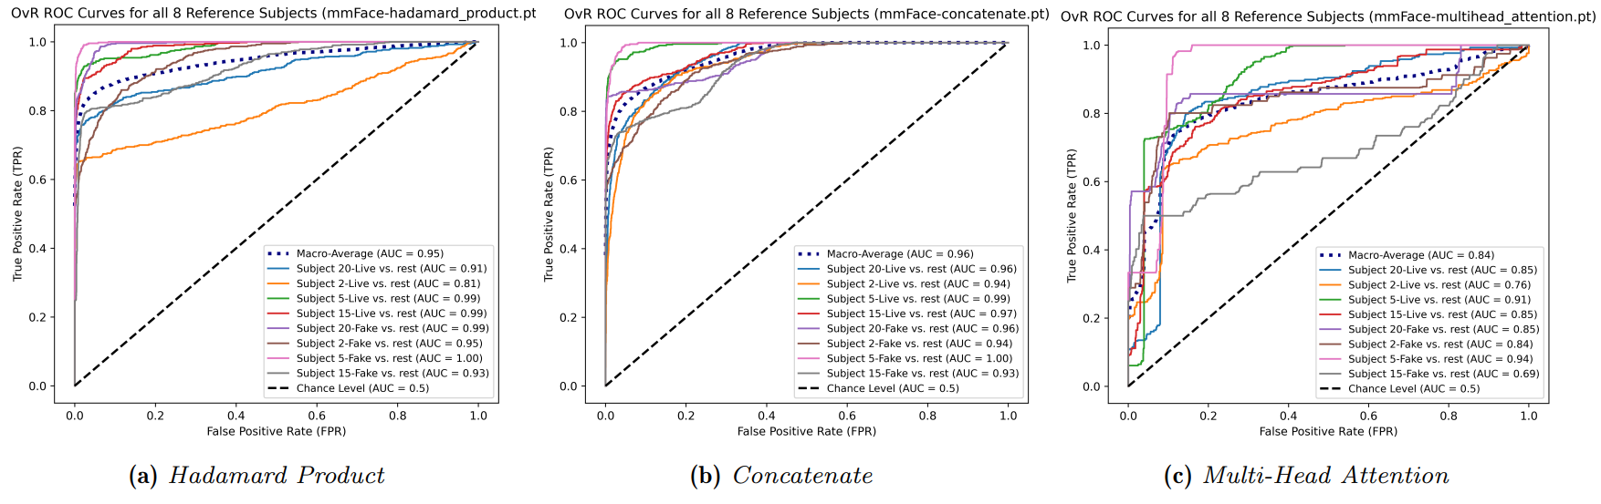
OvR ROC Curves and AUC
Notes:
Firstly, let’s cover the Automatic Videography of Audio.
We aimed to make a tool that autonomously generates illustrated videos for any audio source. This is done by sequencing relevant images that correspond to the spoken language found in the audio.
Motivations:
Past decades have witnessed a rise in popularity of video production on platforms such as YouTube, Instagram, and TikTok etc.
It is often the case that many ‘music videos’ on YouTube lack any video content. Merely showcasing the album cover art. This can be detrimental to their prosperity. Number of reasons for this:
Artists/Bands lack funding, resources and capability to make music videos. Or song not popular enough to warrant the effort.
More commonly arises from older tracks digitised from analogue format to be uploaded to platform.
Studies have proven that introducing multimodality to content can increase user retention, not to mention accessibility.
This could be beneficial with educational material since bringing visual, audio and textual elements can cater to diverse learning styles
Finally, our system intends to enhance and generalise the functionality of the previous automated videography system by Andrew Parker.

Slide 10
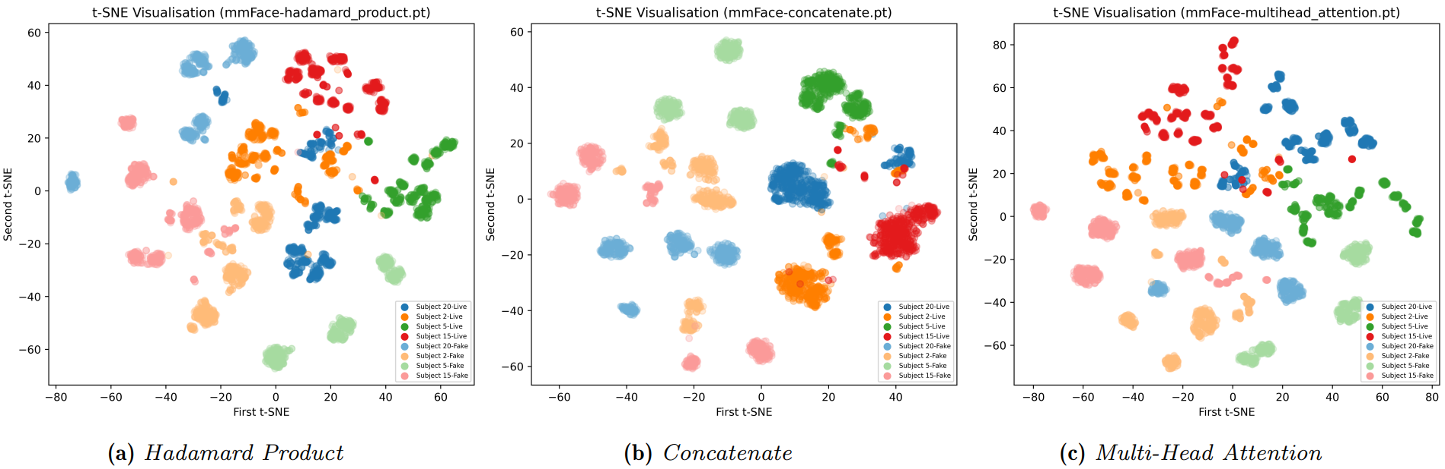
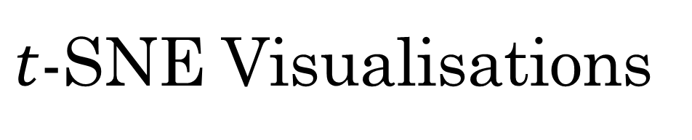
$t$-SNE Visualisations
Notes:
Firstly, let’s cover the Automatic Videography of Audio.
We aimed to make a tool that autonomously generates illustrated videos for any audio source. This is done by sequencing relevant images that correspond to the spoken language found in the audio.
Motivations:
Past decades have witnessed a rise in popularity of video production on platforms such as YouTube, Instagram, and TikTok etc.
It is often the case that many ‘music videos’ on YouTube lack any video content. Merely showcasing the album cover art. This can be detrimental to their prosperity. Number of reasons for this:
Artists/Bands lack funding, resources and capability to make music videos. Or song not popular enough to warrant the effort.
More commonly arises from older tracks digitised from analogue format to be uploaded to platform.
Studies have proven that introducing multimodality to content can increase user retention, not to mention accessibility.
This could be beneficial with educational material since bringing visual, audio and textual elements can cater to diverse learning styles
Finally, our system intends to enhance and generalise the functionality of the previous automated videography system by Andrew Parker.

Slide 11
Discussion of Results
Notes:
Firstly, let’s cover the Automatic Videography of Audio.
We aimed to make a tool that autonomously generates illustrated videos for any audio source. This is done by sequencing relevant images that correspond to the spoken language found in the audio.
Motivations:
Past decades have witnessed a rise in popularity of video production on platforms such as YouTube, Instagram, and TikTok etc.
It is often the case that many ‘music videos’ on YouTube lack any video content. Merely showcasing the album cover art. This can be detrimental to their prosperity. Number of reasons for this:
Artists/Bands lack funding, resources and capability to make music videos. Or song not popular enough to warrant the effort.
More commonly arises from older tracks digitised from analogue format to be uploaded to platform.
Studies have proven that introducing multimodality to content can increase user retention, not to mention accessibility.
This could be beneficial with educational material since bringing visual, audio and textual elements can cater to diverse learning styles
Finally, our system intends to enhance and generalise the functionality of the previous automated videography system by Andrew Parker.

Slide 12

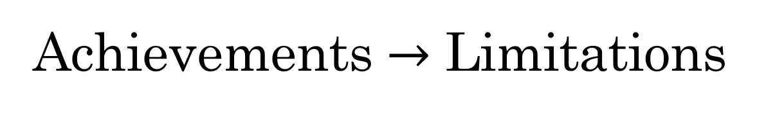
Achievements $→$ Limitations
New system can generate videos for any audio source:
Multilingual – Supports 100 languages
Non-music – Supports robust audio-to-text transcription
– Able to withstand strong accents
Audio Upload – Not restricted to YouTube platform
Semantically relevant images retrieved.
Videos generated quicker and of higher resolution/quality.
User-friendly interface eases ground-truth construction:
Automates audio-to-text transcription and splitting into “chunks”
Relevance assessment more streamlined
Chunks can be revisited and edited
Notes:
What did this project achieve?
The new system is able to generate videos for any audio source, including multilingual supporting over 100 languages, non-musical sources with the robust audio-to-text transcription Whisper models.
In addition, these models can withstand strong accents. Lastly, this system is not restricted to the YouTube platform since users can upload their own audio files as sources.
More semantically relevant images are retrieved leveraging multimodal embedding of images and language.
Videos are generated much quicker and of higher resolution and image quality than the previous system.
The system includes a user-friendly interface that eases ground-truth construction by streamlining the relevance assessment for audio to text to image.
The interface allows chunks to be revisited and edited reducing annotation effort.

Slide 13


Future Work
Resolve multiple user input bug by placing intermediary loading page.
Add audio chunk sound bites for better relevance assessments.
Integrating app with other tools/platforms:
Direct sharing of generated videos to social media.
Integration with YouTube search API.
Integration with Language Translation API.
Pooling depth expansion for ambiguous texts.
Allow input of text sources rather than audio sources.
Notes:
The final product offers a broad range of future work.
Firstly, the bugs identified in the user study should be promptly fixed. An intermediary loading page would prevent further user input
Sound bites can be added to improve relevance assessments since annotators can listen to the audio chunk as well as read them.
Possible integrating the application with other platforms for direct sharing of generated videos,
or bypassing the need for inputting URLs by integrating with the YouTube search
or including a Language Translation layer to allow annotators to easily construct ground-truths for audio sources not in their native language.
An option to expand the pooling depth for ambiguous text prompts can be added in order to assess better images.
Lastly, allowing the user to directly input textual sources rather than audio could be beneficial. Text-to-speech techniques could be utilised during the video generation phase.

Slide 14
Thank you
Any Questions?

